Slide 1
Integrating Multi-Dimensional, Multi-Source Knowledge for Social Media Data Mining
Jingjing Wang
Dept. of Computer Science
University of Illinois at Urbana-Champaign

Slide 2

Emerging Social Media Platforms
Notes:
The development of social media platforms is faster than ever before

Slide 3
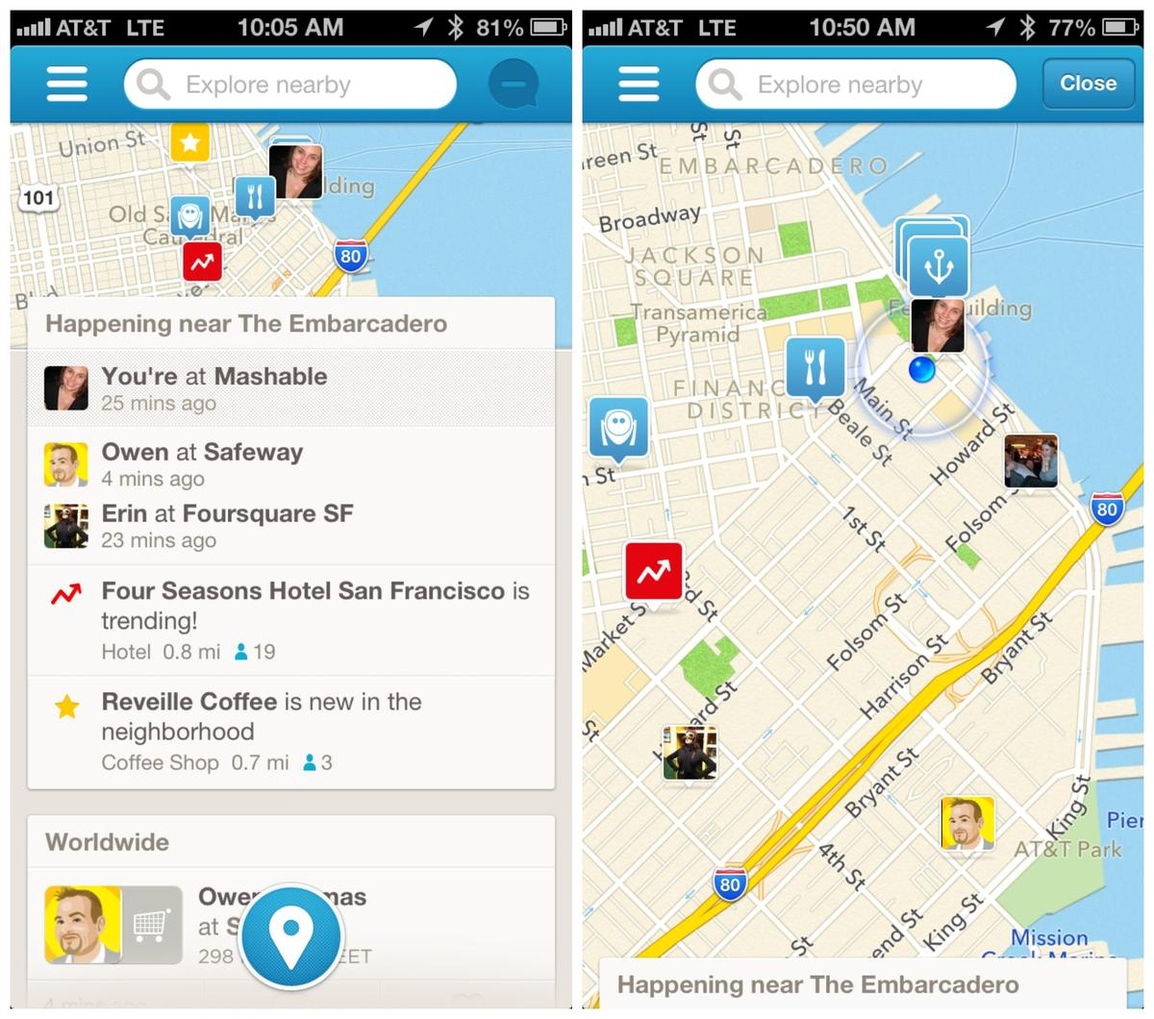
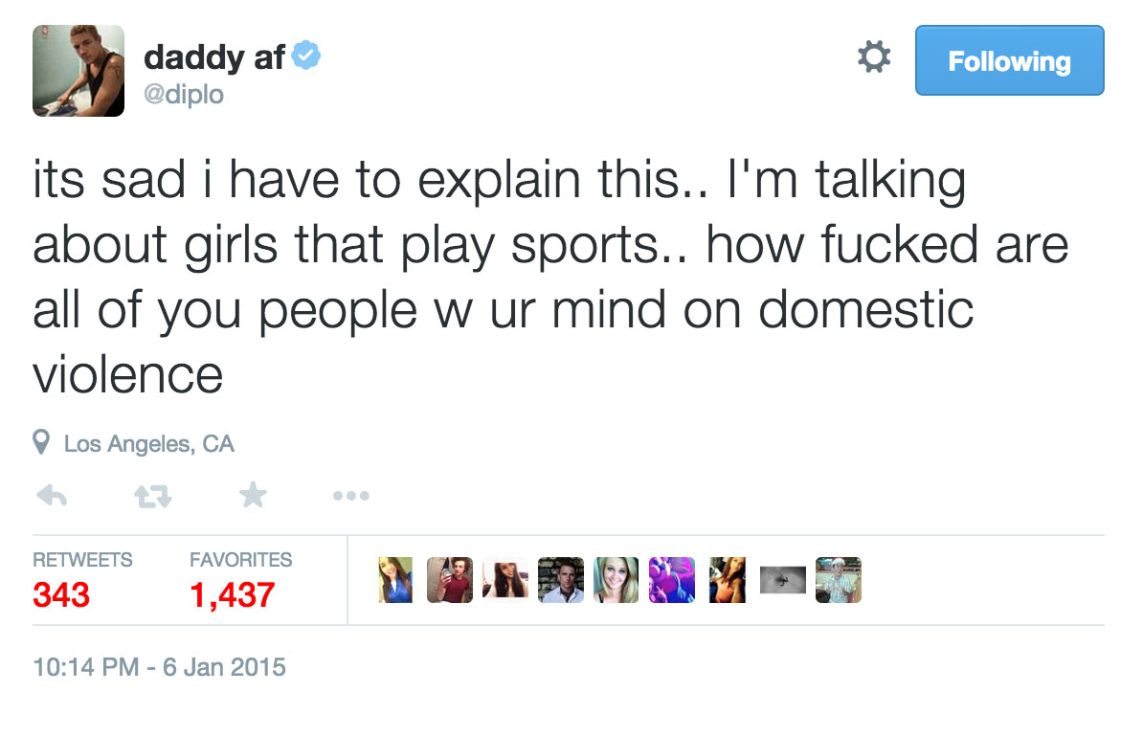
Social Media Data Are Multi-Dimensional in Nature
category
location
time
text
popularity

Slide 4
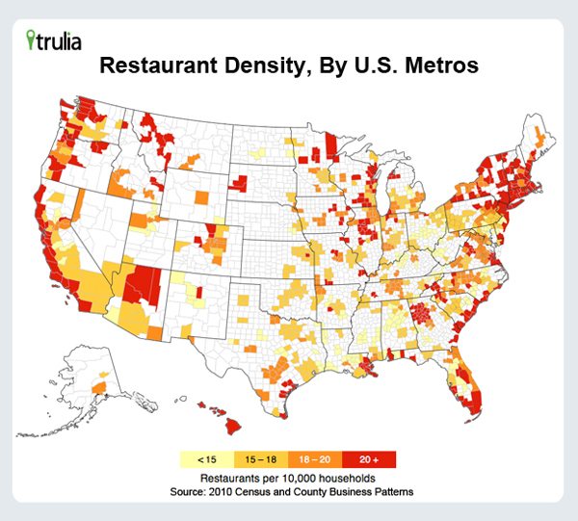
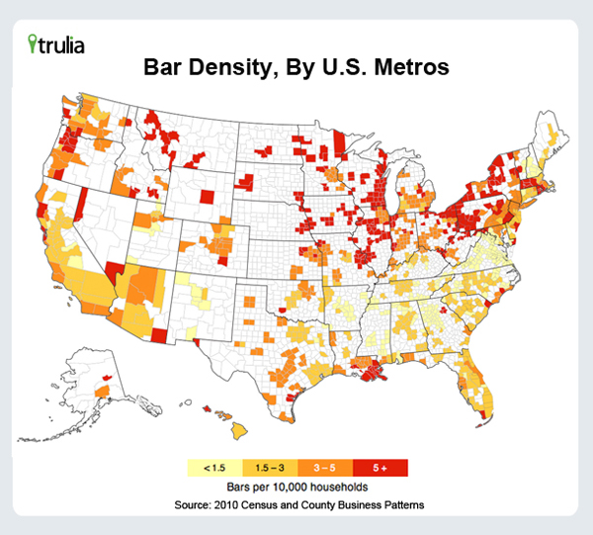
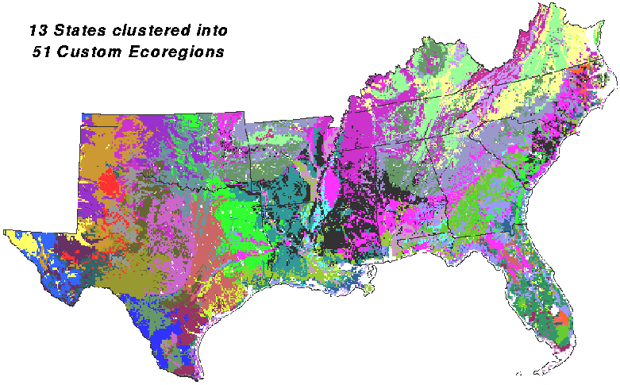
Some Important Dimensions Are Hidden or not Directly Observed
Geographic Clusters
Notes:
These geo clusters do not follow any administrative borderlines or any well-defined partitions.

Slide 5
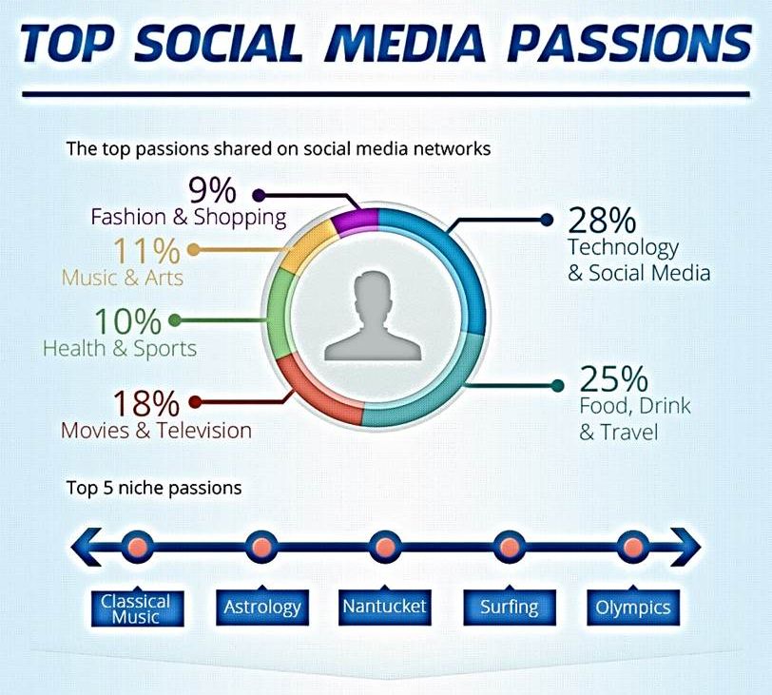
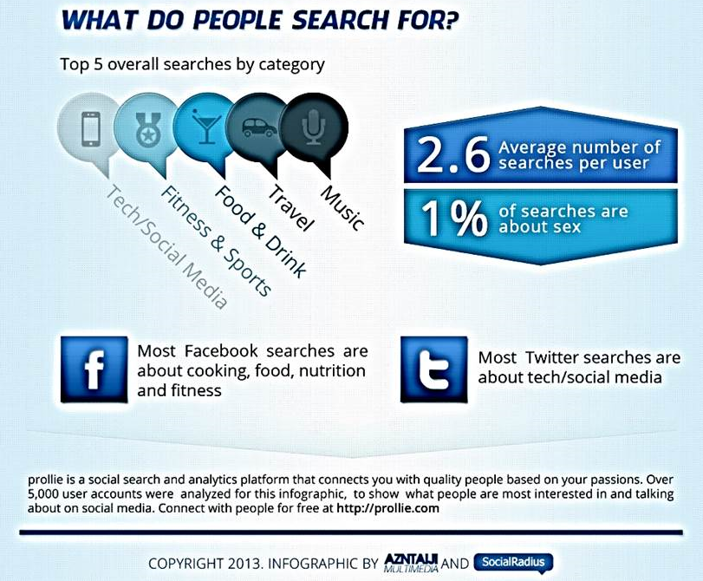
Some Important Dimensions Are Hidden or not Directly Observed
Topics

Slide 6

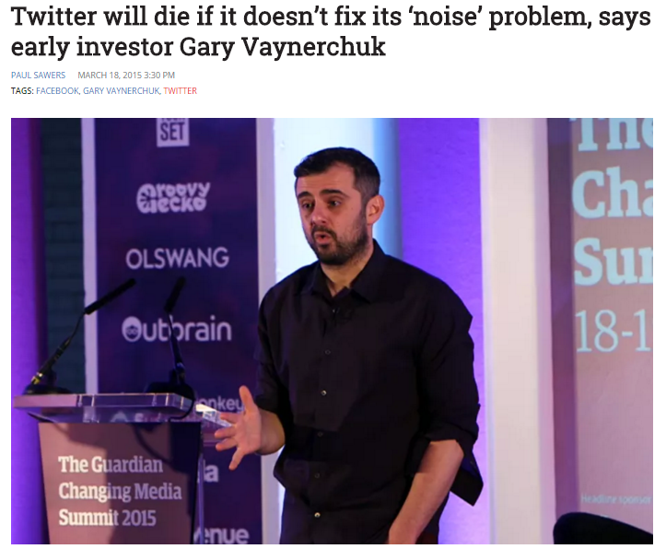
Besides the Heterogeneous Data Types, Social Media is a Noisy Place
Notes:
Therefore, appropriately dealing with noise in social media is critical.

Slide 7

Resort to External Sources
News
Well edited
Comprehensive facts
Real time status update
Notes:
Social media may be noisy. But other sources can be much cleaner
Of course different applications can resort to different sources for noise filtering and guidance. In this dissertation we consider the specific application of event detection, where news can be an ideal source.

Slide 8

How to model multi-dimensional knowledge in a principled way?
How to integrate multi-source information to find desired information and discover interesting knowledge?

Slide 9
Roadmap
[Multi-Dimensional]
A Principled Methodology to Model both Explicit and Implicit Knowledge: a discriminative learning protocol
We present this learning protocol with a concrete application of check-in preference modeling in Foursquare (WSDM ’16)
[Multi-Dimensional and Multi-Source]
Leverage External Sources for Multi-Dimensional Knowledge Discovery in Social Media
Mining Multi-Aspect Reflection of News Events in Twitter: Discovery, Linking and Presentation (ICDM ’15)
EKNOT: Event Knowledge from News and Opinions in Twitter (AAAI ’16)
Proposed Work
Leverage Social Media for Customized Event Profiling in Traditional News Media (In preparation for KDD’16)

Slide 10
A Principled Methodology to Model both Explicit and Implicit Knowledge

Slide 11
The Typical Form of A Maximum Entropy Model for Multi-Class Classification Tasks
x : an observed instance
y : a possible class
Features: f(x , y)
Weights (to be learned): w
Conditional probability P(y|x) ~ exp(w^{T}f(x , y))
w* maximizes H(y|x), the conditional entropy of y given x under P(y|x)

Slide 12
Allow Features to be Latent
A conceptual picture
observed features
prediction
observed features
prediction
latent features
arbitrary parametric forms

Slide 13
Latent Features Are Characterized in Parametric Forms
x : an observed instance
y : a possible class
Features: f(x , y, Θ) = [f^{e}(x , y) , f^{i}(x , y, Θ)]
Weights (to be learned): w(Θ)
Conditional probability P(y|x , Θ) ~ exp(w(Θ)^{T}f(x , y, Θ))
w*(Θ) maximizes H(y|x, Θ), the conditional entropy of y given x under P(y|x , Θ)
How to find the optimal Θ?
latent parameters governing the latent features

Slide 14
Minimax Entropy
The optimal Θ should be chosen such that the maximized conditional entropy H*(y|x, Θ) is minimized:
Θ* = arg min_{Θ}H*(y|x, Θ)
x : an observed instance
y : a possible class
Features: f(x , y, Θ) = [f^{e}(x , y) , f^{i}(x , y, Θ)]
Weights (to be learned): w(Θ)
Conditional probability P(y|x , Θ) ~ exp(w(Θ)^{T}f(x , y, Θ))
w*(Θ) maximizes H(y|x, Θ), the conditional entropy of y given x under P(y|x , Θ)
How to find the optimal Θ?

Slide 15
Summary
Maximum entropy principle
First proposed by E.T. Jaynes in 1957
A very general rationale why we should select the model with the maximum entropy
Widescale applications
Introducing latent variables to discriminative models is not new
The minimax entropy principle was first proposed in the computer vision community by Zhu et al. for feature selection within the MaxEnt framework
Previous work have introduced hidden variables to other discriminative models such as SVMs and CRFs in various forms as well
Allowing features to be governed by a parametric form is innovative
Directly corresponds to the generative assumptions of the features
Especially suited to the situations where multidimensional heterogeneous information need to be modeled
The optimization of the latent parameters is naturally guided by the MinEnt principle
Theoretically elegant
A handy coordinate descent solution

Slide 16
Modeling Check-In Preferences with Multidimensional Knowledge: A Minimax Entropy Approach WSDM ’16

Slide 17
Problem Definition
Goal: Learn a time-aware distribution over (Point-Of-Interest) POIs for each user: p(l|u, t)
x = (u, t)
y = l
Θ = (o, r) : geographic cluster parameters
o = (o₁ , o₂ , … , o_{R}), r = (r₁ , r₂ , … , r_{R}), where o_{i} is the center, and r_{i} is the radius of the i-th geographic cluster

Slide 18
Given a training set of user check-in histories, jointly learn the conditional probability of checking in at POI l given a user u and time t, denoted by π_{utl} = p(l|u,t); and the geographic clustering structure governed by latent parameters o and r.

Slide 19
Feature Design
A toy example
On a Friday evening, Alice just finished yet another week of hard work; she would like to have a great dinner at a seafood restaurant and then she figures a popular Boiling Crab branch is just nearby. Then it is very likely she checks in at this place

Slide 20
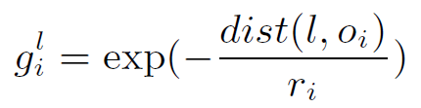
The Model should Accord with the Most Critical Data Statistics
p(l|u,t) matches the empirical statistics in the following feature space
Explicit features (computed by observed user behaviors and the historical visits of a location)
Category Preference f_{c}(u,t,l)
Temporal Preference f_{t}(u,t,l)
Popularity Preference f_{p}(u,t,l)
Latent features
Each location has a geographic signature: a weight vector over geographic clusters
Geographic Preference f_{g}(u,t,l) = <g^{u} , g^{l}>
Notes:
The joint learning approach is motivated by the fact that the clustering structure is not only determined by geographic proximity, but also affected by how well it explains user check-ins.
In sum, the jointly learned
geographic clusters are specially tailored to boost the learning task‘s performance rather than just provide a standalone clustering results

Slide 21
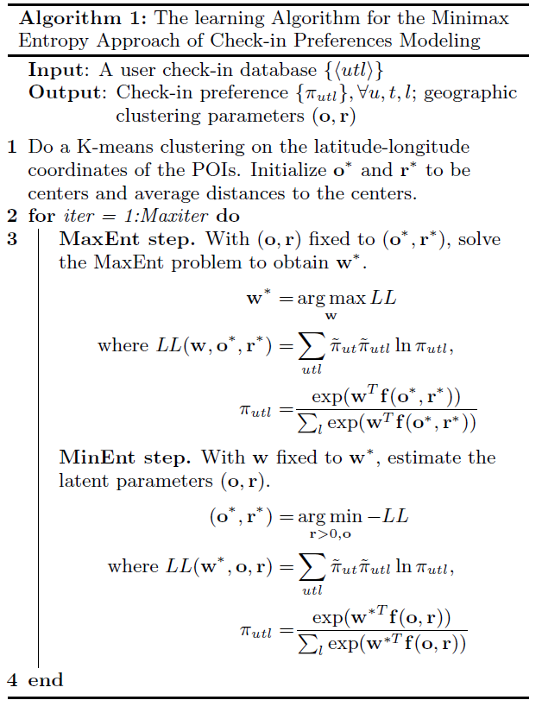
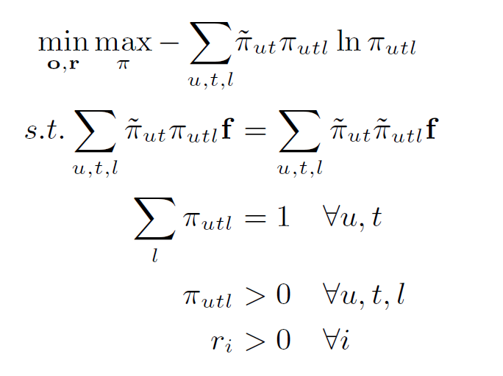
The Optimization Problem

Slide 22
Experiments
Evaluation tasks
Location prediction/recommendation
Foursquare check-in data
CA
483,813 check-in records
4,163 users in California USA
December 2009 - June 2013
World
2,290,996 check-in records
11,326 users around the world
January 2011 to December 2011
Notes:
remove the users and POIs with check-ins fewer than 20
Each check-in record consists of a user ID, a POI ID, a check-in timestamp, and the latitude and longitude of the POI. The rst dataset has the category information of each POI while the second one does not.

Slide 23
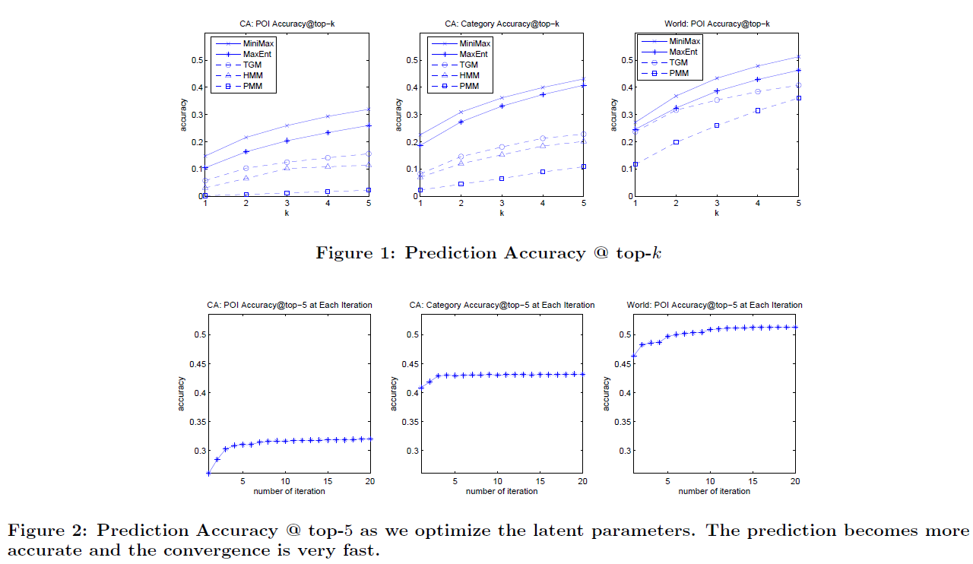
Accuracy of Prediction

Slide 24
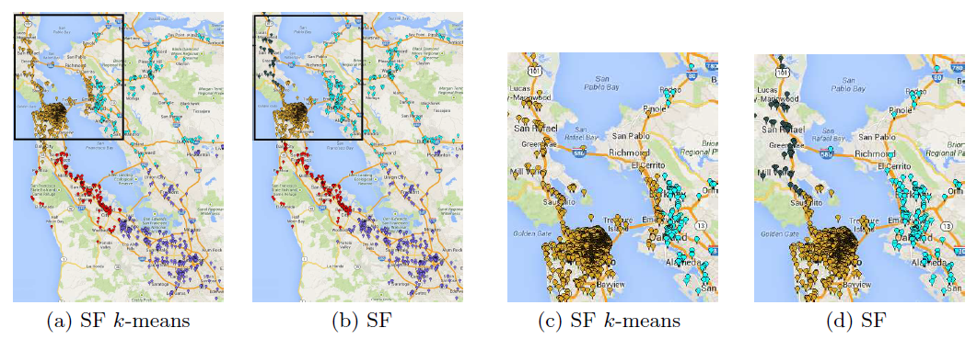
Geographic Clusters
Notes:
we show a snapshot of the San Francisco Bay Area geographic clusters obtained from our algorithm for the CA dataset. We assign each POI l to a cluster by selecting the largest weight.
The optimal clustering structure is rened from the Kmeans clustering via the interaction with the check-in preferences modeling.
As K-means clustering blindly clusters the POIs by geographic latitudes and longitudes, the cluster centered at SF (yellow) stretched to San Rafael, Oakland and Berkeley; while in the rened clusters, SF corresponds to a concentrated cluster. The SF cluster extends north right to the vicinity of the Golden Gate Bridge as tourists
to SF would always like to explore the Golden Gate Bridge.

Slide 25
Contribution
Investigate explicit user and location features, as well as jointly learn the latent geographic clustering
A good balance between explaining seen data and generalizing to unseen data by requiring the model to satisfy meaningful relaxed constraints
A general guidance to model ambiguous features with arbitrary parametric forms
Boost the flexibility and expressiveness of the standard discriminative learning models
Notes:
Our approach has the advantage of investigating explicit user and location features, as well as jointly learning the latent geographic clustering
Our model strikes a good balance between explaining seen data and generalizing to unseen data by requiring the model to satisfy meaningful relaxed constraints
Going beyond the check-in preference modeling, our model also provides a general guidance to model ambiguous features with arbitrary parametric forms, which significantly boosts the flexibility and expressiveness of the standard discriminative learning models

Slide 26
Roadmap
[Multi-Dimensional]
A Principled Methodology to Model both Explicit and Implicit Knowledge: a discriminative learning protocol
We present this learning protocol with a concrete application of check-in preference modeling in Foursquare (WSDM ’16)
[Multi-Dimensional and Multi-Source]
Leverage External Sources for Multi-Dimensional Knowledge Discovery in Social Media
Mining Multi-Aspect Reflection of News Events in Twitter: Discovery, Linking and Presentation (ICDM ’15)
EKNOT: Event Knowledge from News and Opinions in Twitter (AAAI ’16)
Proposed Work
Leverage Social Media for Customized Event Profiling in Traditional News Media (In preparation for KDD’16)

Slide 27
Leverage External Sources for Muldi-Dimensional Knowledge Discovery in Social Media

Slide 28
Motivation
Social media data
Unstructured
Fragmented
Noisy
Motivating us to leverage external sources for better knowledge discovery
News
Written in formal language
Comprehensive descriptions and facts

Slide 29
Mining Multi-Aspect Reflection of News Events in Twitter: Discovery, Linking and Presentation ICDM ’15

Slide 30
News Media and Social Media Provide Complementary Views of an Event
An influential event took place…
News reports
Objective and comprehensive description
Social media (e.g. Twitter)
Opinions and sentiments
Example
A news article with the following headline
A tweet on the same event

Slide 31
Existing Work
(Guo et al., 2013 Linking tweets to news: A framework to enrich short text data in social media.)
Finds the most relevant news articles to enrich a given tweet
(Tsagkias et al., 2011 Linking online news and social media)
Retrieves related social media utterances to a given news article
Our work
A global perspective
Event level summaries of both sources simultaneously

Slide 32
A Comprehensive View of Events from Both Sources
Given a time period
What are the major events?
Who are the key players in each event
How people talk about each event
When is the event and how long does the event last?

Slide 33
One More Observation
A major event can have multiple aspects (perspectives/sub-events)
Sony Pictures Entertainment Hack event around December 2014
Raises doubts on if North Korea is responsible for the hack
Unexpectedly promotes the film “the Interview” and leads to a big success for its online release
Attracts attention from the White House
The mining process should be able to distinguish different aspects for each event
Root (Pseudo Node)
Event 1
Event 2
Event 3
Aspect 1
Aspect 3
Aspect 2

Slide 34
Example Output
The event: Sony Pictures Entertainment Hack
Aspect 1: North Korea internet goes down
Aspect 2: The release of the film “The Interview”

Slide 35
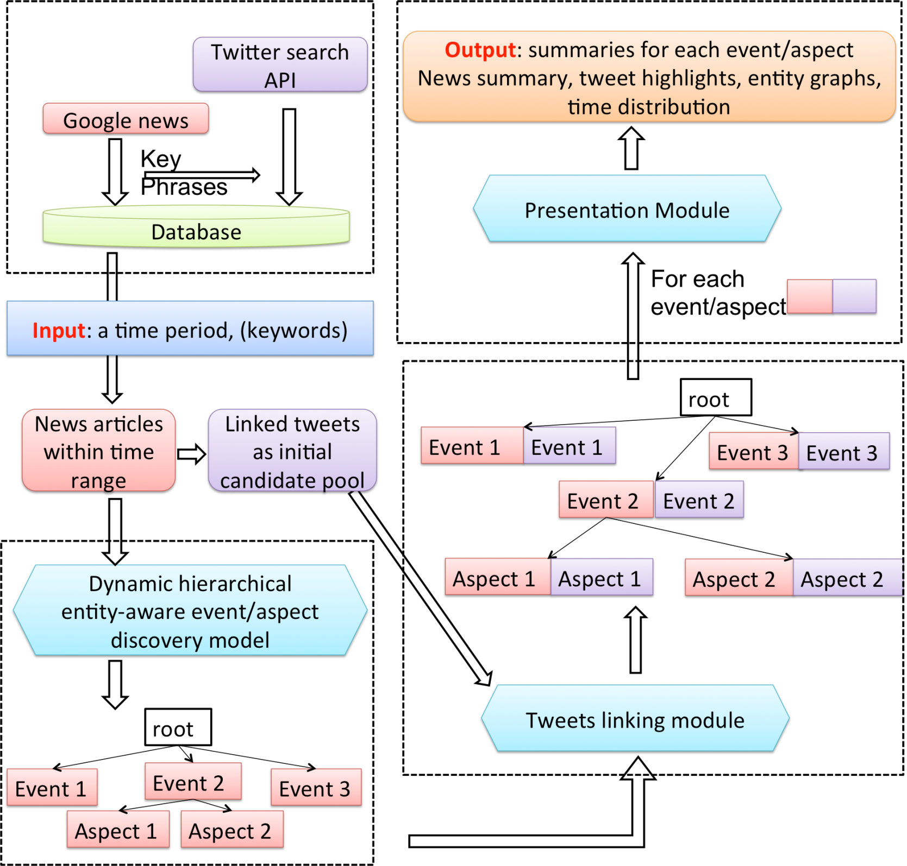

Slide 36
Key Modules
Mining multi-aspect reflections of news events in Twitter
Event and Aspect Discovery in News
A dynamic hierarchical entity-aware topic discovery model to learn news events and their multiple aspects
Linking with Tweets
The aspects of an event are linked to their reflections in Twitter by information retrieval + a bootstrapped dataless classification scheme

Slide 37
Event and Aspect Discovery in News
Hierarchical topic modeling in a top-down manner
Root
Upper level topics are events
Lower level topics are aspects
Recursive discovery of topics at each level
root
Event 1
Event 2
Event 3
Aspect 1
Aspect 3
Aspect 2

Slide 38
Generative Model for Each Level
Input I
Word-document matrix X
Entity-document matrices E
Entity can be person/location/organization
Timestamps of each document T
Output
For each event/aspect
A word distribution
Entity distributions
A time distribution

Slide 39
Generative Model for Each Level
Shared topic distribution for different dimensions (words/entities/time)
Generate Words
φ^{w}
φ^{w}_{B}
K
Generate Entities
θ
z^{w}
w
s^{w}
N^{w}
Generate time
z^{t}
s^{t}
λ_{B}
μ_{B}
t
z^{e}
e
s^{e}
N^{e}
σ_{B}
Backgound topic: the collection’s language model
E
D
μ
σ
φ^{e}_{B}
K
K
φ^{e}
K
E
E

Slide 40
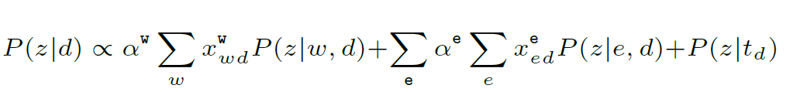
Topic Distribution
Different dimensions jointly affect the topic distribution for each document
words
time
entities

Slide 41
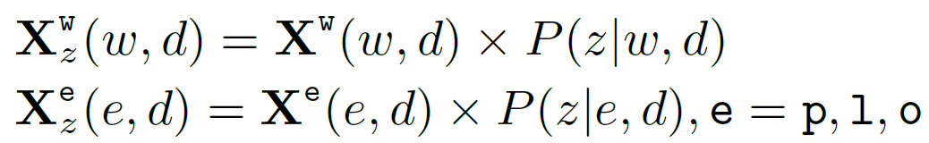
Decomposing I
For each event
Input I_{e} is in the same format
Word-document matrix X_{e}
Entity-document matrices E_{e}
Timestamps of each document T_{e}
I_{e} is decomposed from I
X₁ +X₂ +X₃ +… = X
E₁ +E₂ +E₃ +… = E
T_{e} = T
Constraint
The background word/entity distribution for all the aspects within an event is the event’s word/entity distribution
root: I
Event 1: I₂
Event 2: I₂
Event 3: I₂
Aspect 1
Aspect 3
Aspect 2
Notes:
As we said before, our algorithm is recursive in a top-down manner. The critical part of this algorithm is how to decompose the input of a parent to form the input of its children.
This constraint is to encourage all the aspects are derived from the common theme of their parent event, and meanwhile have their own emphses

Slide 42
Find the Reflection of Each Aspect in Twitter
Challenges
High volumes of twitter stream
Vocabulary gap between news and tweets
Noisy tweets irrelevant to news
Our solution
Retrieval + bootstrapping
Notes:
Now we have the event/aspect distributions as accurate descriptors, we want to use these descriptors to guide event discovery in twitter

Slide 43
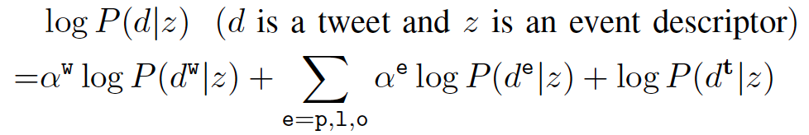
Retrieval
Retrieve a candidate pool of tweets with the event descriptor as a query
Query Likelihood Language Model
Rank documents (tweets) by the probability of being generated by the query
words
entities
time

Slide 44
Bootstrapped Dataless Multi-Class Classification
Select and rank the candidate tweets for each aspect in the event
Initialize M most confident seed tweets for each aspect using the aspect descriptors. The confidence is measured by the score from the language model
For each iteration, train a classifier based on the current set of labeled data and label N more tweets for each aspect
Repeat Step 2 until a desired number of tweets for each aspect are retrieved or the confidence score is lower than a threshold.
Bootstrapping
Weigh the semantic representation extracted from news in a way that best fits the specific tweet collection
Naturally close the vocabulary gap
The classifier can be any multi-class classifier taking arbitrary features

Slide 45
Experiments
Data
TopStory. Top stories from Google news (3,747) + crawled tweets using the noun phrases in the titles of the news articles (36,149,019)
Link. A collection of tweets (34,888) containing URLs + the URL referred NYTIMES/CNN news articles (12,704) prepared by (Guo et al.,2013)
Entities extracted by DBpedia Spotlight

Slide 46
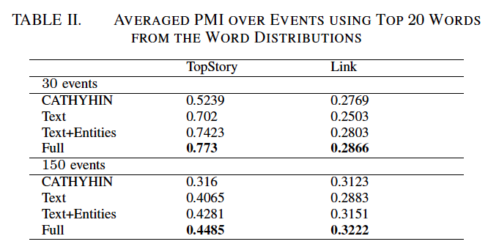
Effectiveness of the Event/Aspect Discovery
Comparison of methods
Our model with words
Our model with words/entities
Our full model with words/entities/time
CATHYHIN
A state-of-art topic hierarchy construction algorithm

Slide 47
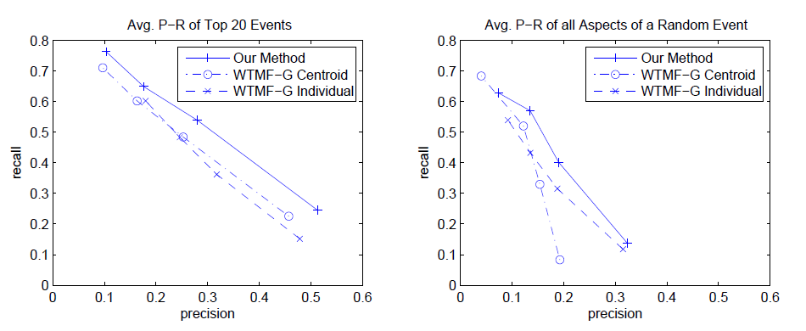
Effectiveness of the Tweet Linking Module
Precision and recall on tweet retrieval
Compare with the WTMF-G (Guo et al.,2013)

Slide 48
Presentation of Results
To answer the questions we raised in the beginning:
What are the major events?
Who are the key players in each event
How people talk about each event
When is the event and how long does the event last?
What are the multiple aspects (sub-events) if the event is big and influential, and what are the answers to the above questions for each aspect?
We output
An Entity Graph (entity distribution)
A Time Span (time distribution)
News summary ( titles of news with top p(d|z) )
Tweet highlights ( top ranked tweets by the bootstrapping score )

Slide 49
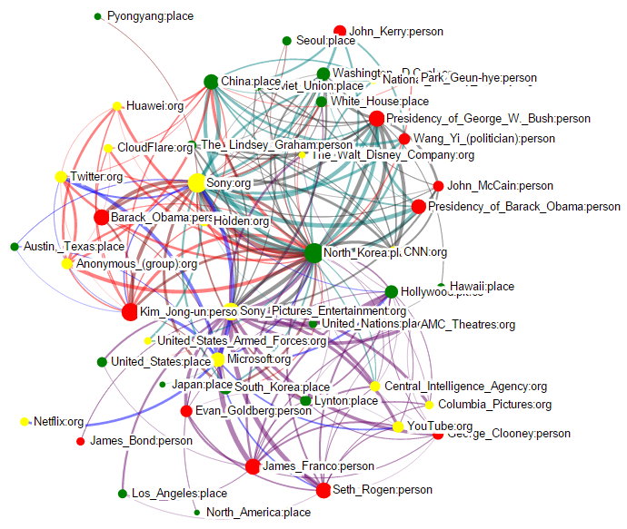
Entity Graph
Notes:
Fig. 5. Entity Graph in the Event View. Red node: person; Green node: place; Yellow node: organization. The size of the node denotes the influence of the entity in this event. The width of the edge denotes the strength of the correlation between two entities. Different colors of edges represent the correlations in different aspects. We can see the influential entities in this event are: “Sony”, “North Korea”, “Kim Jong-un”,“Barack Obama”, “Seth Rogen (director and actor of the film)” and “James Franco (actor of the film)” .

Slide 50
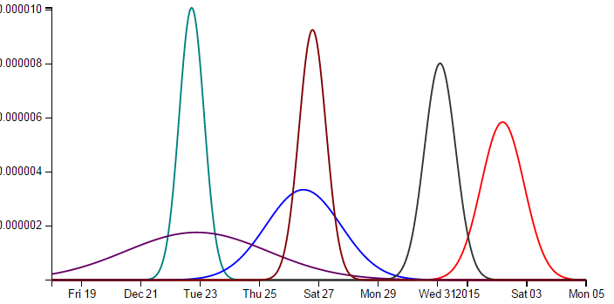
Time Spans

Slide 51
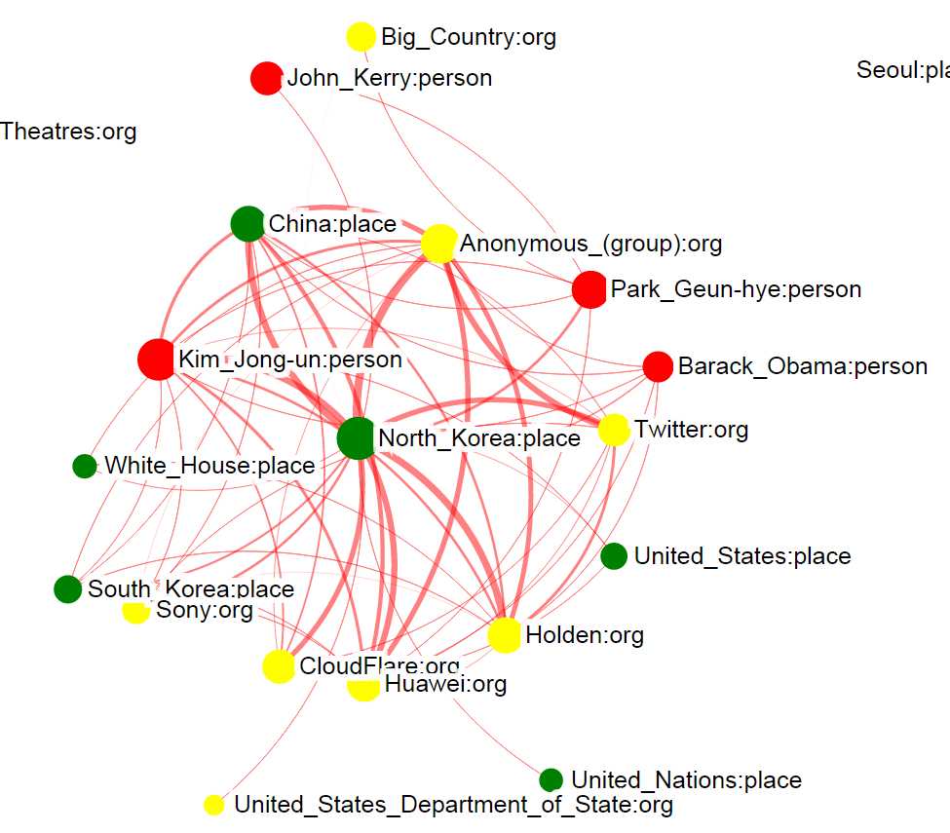
Zoom in to the Entity Graph of the Red Aspect about “North Korea Internet Outage”. The size of a node denotes the influence of the entity in the aspect. The width of an edge denotes the strength of the correlation between two entities.

Slide 52
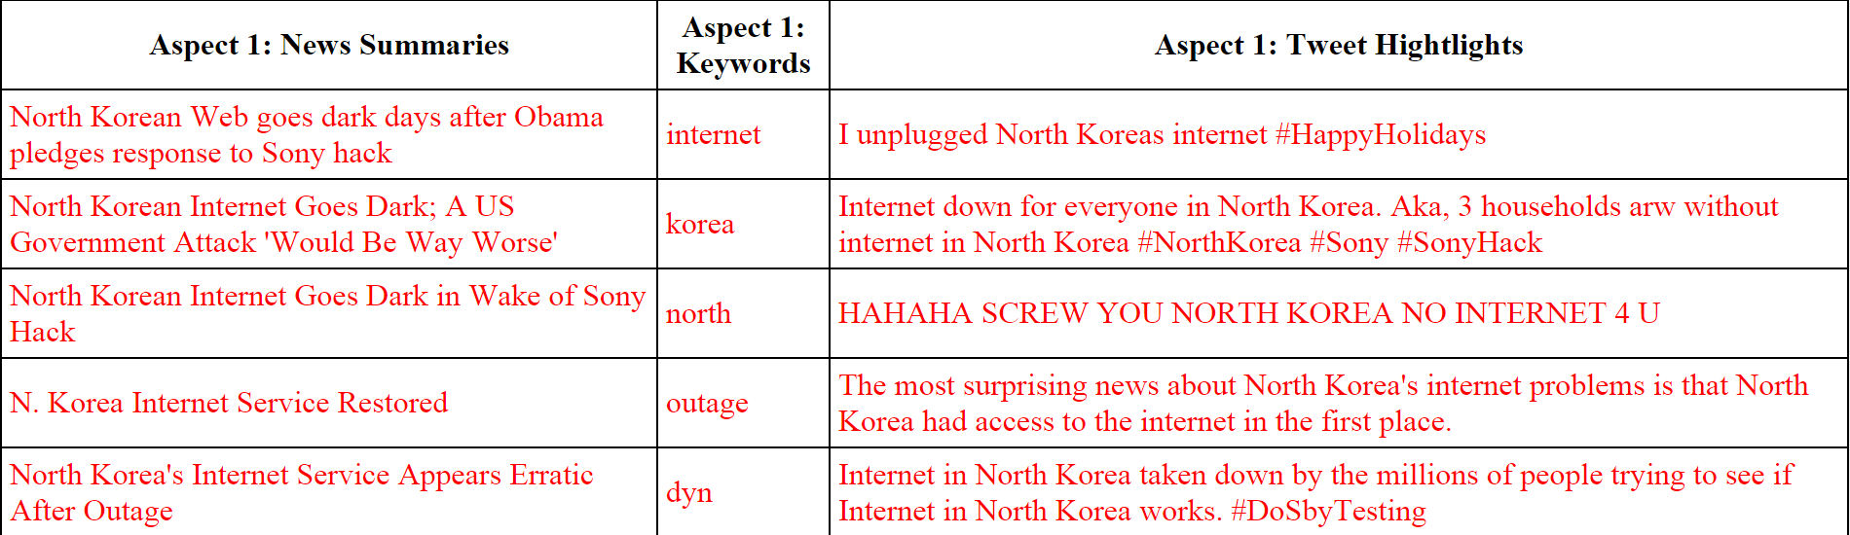
News Summary, Keywords and Tweet Highlight of the Aspect “North Korea Internet Outage” in the Sony Hack Event

Slide 53
Contribution
A unified framework to mine multi-aspect reflections of news events in Twitter
An effective time and entity-aware event/aspect discovery model to learn accurate descriptors of news events and their multiple aspects
The aspects of an event are linked to their reflections in Twitter by multidimensional information retrieval + bootstrapped dataless classification
Completely unsupervised
Select informative tweets under overwhelming noise
Bridge the vocabulary gap between news and tweets
To facilitate user digestion, our framework naturally outputs an multidimensional summary of each event with
Entity graphs
Time spans
News summaries
Tweet highlights

Slide 54
Demo: E-KNOT - Event Knowledge from News and Opinions in Twitter AAAI ’16
A refined summarization module
Co-rank news articles and tweets for a better joint summarization
Besides the multi-dimensional relevance, we consider
Sentiment polarity
Redundancy
Demo

Slide 55
Roadmap
[Multi-Dimensional]
A Principled Methodology to Model both Explicit and Implicit Knowledge: a discriminative learning protocol
We present this learning protocol with a concrete application of check-in preference modeling in Foursquare (WSDM ’16)
[Multi-Dimensional and Multi-Source]
Leverage External Sources for Multi-Dimensional Knowledge Discovery in Social Media
Mining Multi-Aspect Reflection of News Events in Twitter: Discovery, Linking and Presentation (ICDM ’15)
EKNOT: Event Knowledge from News and Opinions in Twitter (AAAI ’16)
Proposed Work
Leverage Social Media for Customized Event Profiling in Traditional News Media (In preparation for KDD’16)

Slide 56
Proposed Work: Leverage Social Media for Customized Event Profiling in Traditional News Media
Notes:
We have seen that traditional news media offer high-quality reference context for social media, which greatly benefits knowledge discovery in social media. However, the gain does not have to be one-way. We propose to leverage ..

Slide 57
Social Media Bring New Perspectives to Traditional News Mining Tasks
Social media posts reflect people's true feelings
Integrating social media inspires new applications
Opinion-worthy event detection
Twitter-customized news summarization
Notes:
In fact, the posts in social media reflect people's true feelings and what they really care about. Integrating social media brings a new perspective to the traditional news mining tasks, and can inspire many applications…

Slide 58
Problem Definition
Given an event
A set of news articles
A set of tweets
Extract multiple aspects of this event based on people's interest
Output for each aspect
Representative sentences in news
Representative tweets
Entitie graphs
Time span
Social impact score

Slide 59
Intuition
Aspects may be ambiguous and hard to define by only investigating the text of news articles
Leveraging social media such as Twitter, we obtain a well-defined problem
Extract multiple aspects of an event by observing people's interest peaks
Assumption
Instead of going into every detail of a complex event, people's attention tend to form multiple peaks
An integrated study of news and tweets
Clearly reveal the aspects having significant social impact

Slide 60
Key Stages
Knowledge Graph Construction from News Articles
Customize the Knowledge Graph by Twitter: Use Tweets for Voting
Aspect Discovery on the Refined Knowledge Graph

Slide 61
Knowledge Graph Construction from News Articles
News articles about an event
=> A heterogeneous graph of
Typed entities as nodes
Relation phrases as edges
Initialized by co-occurrence
Common attributes for nodes/edges
Context word distribution
Context time distribution
Node attributes
Entity features {#doc it appears in, entropy of doc distribution}
Corresponding list of news articles
Edge attributes
Similarity of the two end nodes
Features {#occurrence in doc, in sentence, in paragraph}

Slide 62
Customize the Knowledge Graph by Twitter: Use Tweets for Voting
Use hashtag as the smallest unit
Identify the influence region of a tweet cluster in the knowledge graph
Identify entities in a tweet cluster and map the cluster onto the knowledge graph
Compare the word/time/etc distributions of the tweet cluster to neighboring entities
Propagate as appropriate
Additively increase the density within the influence of the tweet cluster

Slide 63
Tweets must be relevant to this event, representative of the true distribution
Thresh % of entities in the tweet cluster be covered in the entity graph + similar distributions with the node
Rank tweet clusters first before using them for voting (static rank - popularity based + PageRank)
Different tweet clusters increase the density to different extent

Slide 64
Aspect Discovery on the Refined Knowledge Graph
Clustering on the new knowledge graph
A sub knowledge graph is the anchor of an aspect
Densely correlated entities and relations, together with their context word/time distributions
Go back to the news articles by looking at the nodes in each aspect
Summarize the corresponding documents with the anchor ( a tweet enhanced sub knowledge graph)
Sentences with the salient entities should be given higher weight

Slide 65
News

Slide 66
Projecting Tweets…

Slide 67
Projecting Tweets…

Slide 68
Interest Peaks

Slide 69
Interest Peaks
Barack_Obama
Kim_Jong-un
White_House
Internet
North_Korea
James_Franco
Context words: film, interview, theaters, movie, release, rogen, sony, comedy
Seth_Rogen
Sony_Pictures
YouTube
The_Interview
Relation phrases: releases/announces/promotes

Slide 70
Discussions
Noise are reduced
Unimportant events/aspects in news that are not mentioned in tweets are demoted
Noisy tweets that are not newsworthy are not considered in the first place
Why network?
When we decide the influence region of a tweet cluster, the influence may be propagated over the network

Slide 71
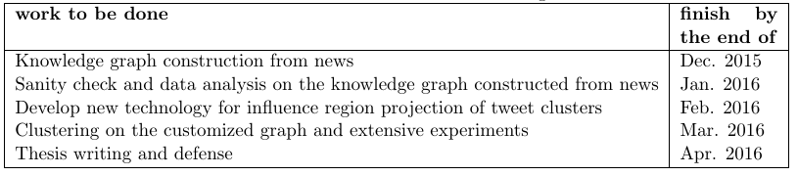
Research Plan

Slide 72
Recap
[Multi-Dimensional]
A Principled Methodology to Model both Explicit and Implicit Knowledge: a discriminative learning protocol
We present this learning protocol with a concrete application of check-in preference modeling in Foursquare (WSDM ’16)
[Multi-Dimensional and Multi-Source]
Leverage External Sources for Multi-Dimensional Knowledge Discovery in Social Media
Mining Multi-Aspect Reflection of News Events in Twitter: Discovery, Linking and Presentation (ICDM ’15)
EKNOT: Event Knowledge from News and Opinions in Twitter (AAAI ’16)
Proposed Work
Leverage Social Media for Customized Event Profiling in Traditional News Media (In preparation for KDD’16)

Slide 73
Selected Publications
Min Li*, Jingjing Wang*, Wenzhu Tong, Hongkun Yu, Xiuli Ma, Yucheng Chen, Haoyan Cai, Jiawei Han, "EKNOT: Event Knowledge from News and Opinions in Twitter", Proc. of AAAI Conf. on Artificial Intelligence (AAAI'16) (system demo), Phoenix, AZ, Feb. 2016 (* equal contribution)
Jingjing Wang, Min Li, Jiawei Han, Xiaolong Wang, "Modeling Check-in Preferences with Multidimensional Knowledge: A Minimax Entropy Approach", in Proc. of 2016 Int. Conf. on Web Search and Data Mining (WSDM'16), San Francisco, CA, Feb. 2016.
Jingjing Wang, Wenzhu Tong, Hongkun Yu, Min Li, Xiuli Ma, Haoyan Cai, Tim Hanratty, and Jiawei Han, "Mining Multi-Aspect Reflection of News Events in Twitter: Discovery, Linking and Presentation", in Proc. of 2015 IEEE Int. Conf. on Data Mining (ICDM'15), Atlantic City, NJ, Nov. 2015.
Jingjing Wang, Hongbo Deng, and Jiawei Han, "Topic Periodicity Discovery from Text Data", in Proc. SPIE Vol. 9499, Next-Generation Analyst III, Baltimore, Maryland, April 2015
Zhenhui Li, Jingjing Wang, and Jiawei Han, "ePeriodicity: Mining Event Periodicity from Incomplete Observations", IEEE Transactions on Knowledge and Data Engineering (TKDE), 27(5): 1219-1232 (2015)
Jingjing Wang, Changsung Kang, Yi Chang and Jiawei Han, "A Hierarchical Dirichlet Model for Taxonomy Expansion for Search Engines", Proc. of 2014 Int. World-Wide Web Conf. (WWW'14), Seoul, Korea, April 2014.
Mudhakar Srivatsa, Raghu Ganti, and Jingjing Wang, "Map Matching: Facts and Myths" (poster), 21st ACM SIGSPATIAL Int. Conf. on Advances in Geographic Information Systems (ACM SIGSPATIAL GIS 2013), Orlando, Florida, USA, Nov. 2013.
Zhenhui Li, Jingjing Wang, and Jiawei Han, "Mining Periodicity for Sparse and Incomplete Event Data", Proc. of 2012 ACM SIGKDD Int. Conf. on Knowledge Discovery and Data Mining (KDD'12), Beijing, China, Aug. 2012.
Jingjing Wang and Bhaskar Prabhala, "Periodicity Based Next Place Prediction", Proc. of Workshop on Mobile Data Challenge by Nokia (in conjunction with Pervasive 2012), Newcastle, UK, June 2012.
Thank You!

